Slide 1
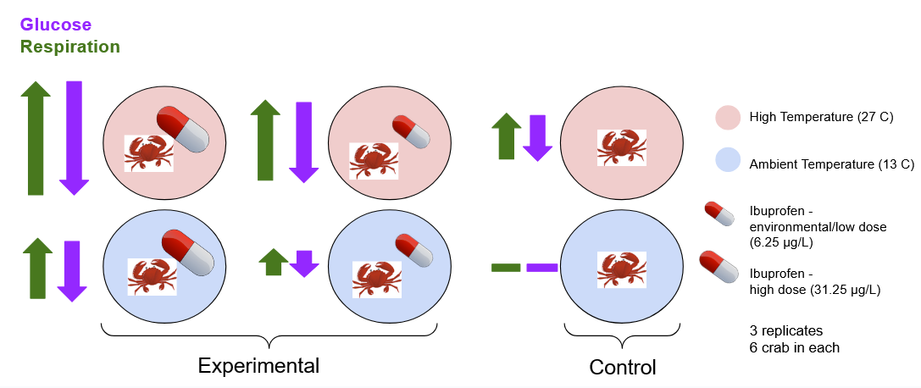
The Ecophysiological Effects of Water Temperature and Ibuprofen on Hemigrapsus oregonensis
Research Question:
How will increasing concentrations of ibuprofen affect glucose and respiration rates in H. oregonensis?
How will an increase in temperature affect glucose and respiration rates in H. oregonensis?
How will the combined effects of ibuprofen concentrations and increased temperature affect glucose and respiration rates in H. oregonensis?
Hypotheses:
Methods:
Oxygen consumption → resazurin each week
30 min
60 min
90 min
Glucose levels → hemolymph extraction last day
Tank cleaning each week
Re-dosed tanks after cleaning
Notes:
Jason - title and questions
Jolee - hypotheses and methods
Alexias - results

Slide 2
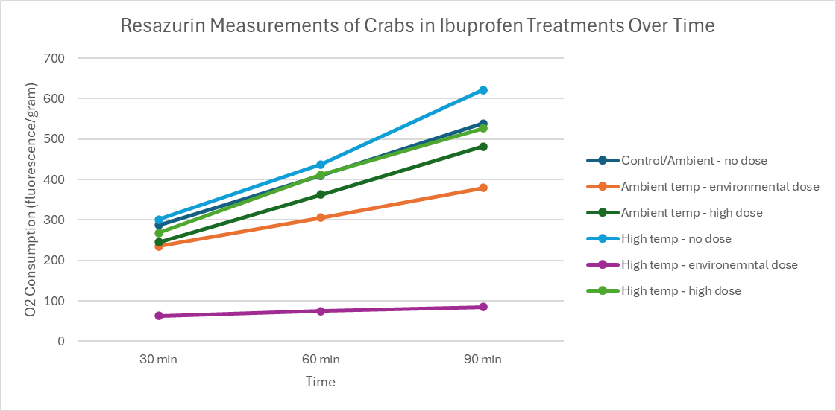
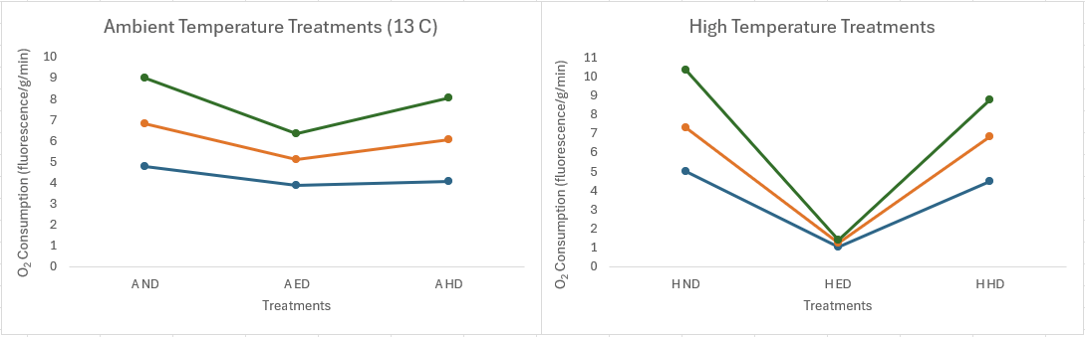

Data analysis:
Resazurin: averages (once we get 2nd results), visualization
Glucose/Lactate: average across all 3 crabs, visualization
Results:
Lowest O₂ consumption - high temp & environmental dose
Highest O₂ consumption - High temp & no dose
Prediction:
Stress is ignored when influenced by Ibuprofen
Drug threshold
(27 C)
Mortality:
2 male deaths
Ambient temp & high dose
High temp & no dose

